Slide 1
Operating-System Structures

Slide 2
Operating System Services
Operating systems provide an environment for execution of programs and services to programs and users
One set of operating-system services provides functions that are helpful to the user:
User interface - Almost all operating systems have a user interface (UI).
Varies between Command-Line (CLI), Graphics User Interface (GUI), Batch
Program execution - The system must be able to load a program into memory and to run that program, end execution, either normally or abnormally (indicating error)
I/O operations - A running program may require I/O, which may involve a file or an I/O device

Slide 3
Operating System Services (Cont.)
One set of operating-system services provides functions that are helpful to the user (Cont.):
File-system manipulation - The file system is of particular interest. Programs need to read and write files and directories, create and delete them, search them, list file Information, permission management.
Communications – Processes may exchange information, on the same computer or between computers over a network
Communications may be via shared memory or through message passing (packets moved by the OS)
Error detection – OS needs to be constantly aware of possible errors
May occur in the CPU and memory hardware, in I/O devices, in user program
For each type of error, OS should take the appropriate action to ensure correct and consistent computing
Debugging facilities can greatly enhance the user’s and programmer’s abilities to efficiently use the system

Slide 4
Operating System Services (Cont.)
Another set of OS functions exists for ensuring the efficient operation of the system itself via resource sharing
Resource allocation - When multiple users or multiple jobs running concurrently, resources must be allocated to each of them
Many types of resources - CPU cycles, main memory, file storage, I/O devices.
Accounting - To keep track of which users use how much and what kinds of computer resources
Protection and security - The owners of information stored in a multiuser or networked computer system may want to control use of that information, concurrent processes should not interfere with each other
Protection involves ensuring that all access to system resources is controlled
Security of the system from outsiders requires user authentication, extends to defending external I/O devices from invalid access attempts

Slide 5
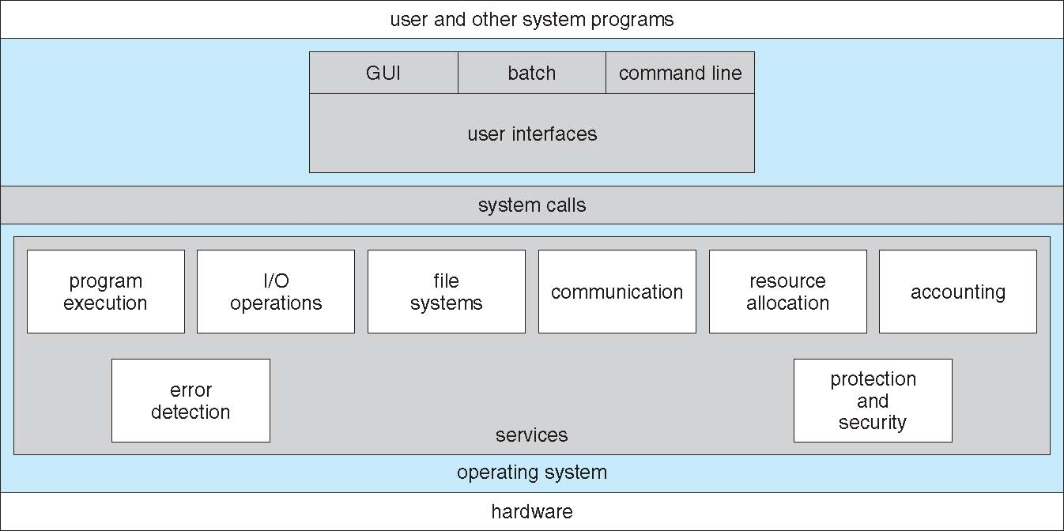
A View of Operating System Services

Slide 6
System Calls
Programming interface to the services provided by the OS
Typically written in a high-level language (C or C++)
Mostly accessed by programs via a high-level Application Programming Interface (API) rather than direct system call use
Three most common APIs are Win32 API for Windows, POSIX API for POSIX-based systems (including virtually all versions of UNIX, Linux, and Mac OS X), and Java API for the Java virtual machine (JVM)
Note that the system-call names used throughout this text are generic

Slide 7
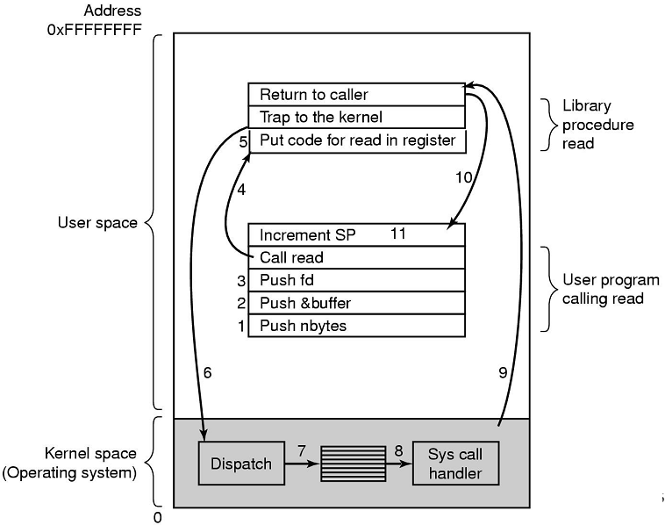
Sys Calls

Slide 8
System Calls
1. Parametreler yığına(stack) eklenir. 2. read sistem çağrısı için read kütüphane fonksiyonu çağrılır. 3. yazmaç içeriğine read sistem çağrısına karşılık gelen değer konulur. 4. bir Interrupt ile kontrol çekirdeğe verilir. 5. çekirdek hangi sistem çağrısının gerçekleştirileceğine parametre ve yazmaçdaki değeri inceleyerek karar verir. Uygun sistem çağrısı işleyicisini (IH) çalıştırır. Sistem çağrısı bittikten sonra çağıran kütüphane fonksiyonunu geri dönülür. 6. Kütüphane fonksiyonu kendisini çağıran kullanıcı programına geri döner.

Slide 9
System Call Parameter Passing
Often, more information is required than simply identity of desired system call
Exact type and amount of information vary according to OS and call
Three general methods used to pass parameters to the OS
Simplest: pass the parameters in registers
In some cases, may be more parameters than registers
Parameters stored in a block, or table, in memory, and address of block passed as a parameter in a register
This approach taken by Linux and Solaris
Parameters placed, or pushed, onto the stack by the program and popped off the stack by the operating system
Block and stack methods do not limit the number or length of parameters being passed

Slide 10
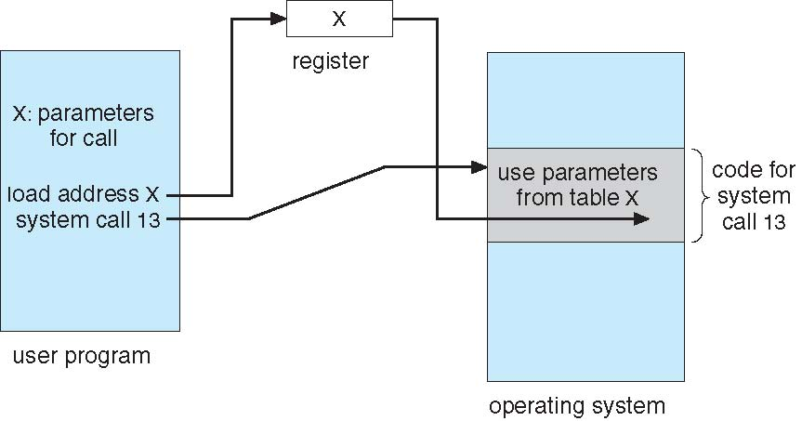
Parameter Passing via Table

Slide 11
Types of System Calls
Process control
create process, terminate process
end, abort
load, execute
get process attributes, set process attributes
wait for time
wait event, signal event
allocate and free memory
Dump memory if error
Debugger for determining bugs, single step execution
Locks for managing access to shared data between processes

Slide 12
Types of System Calls
File management
create file, delete file
open, close file
read, write, reposition
get and set file attributes
Device management
request device, release device
read, write, reposition
get device attributes, set device attributes
logically attach or detach devices

Slide 13
Types of System Calls (Cont.)
Information maintenance
get time or date, set time or date
get system data, set system data
get and set process, file, or device attributes
Communications
create, delete communication connection
send, receive messages if message passing model to host name or process name
From client to server
Shared-memory model create and gain access to memory regions
transfer status information
attach and detach remote devices

Slide 14
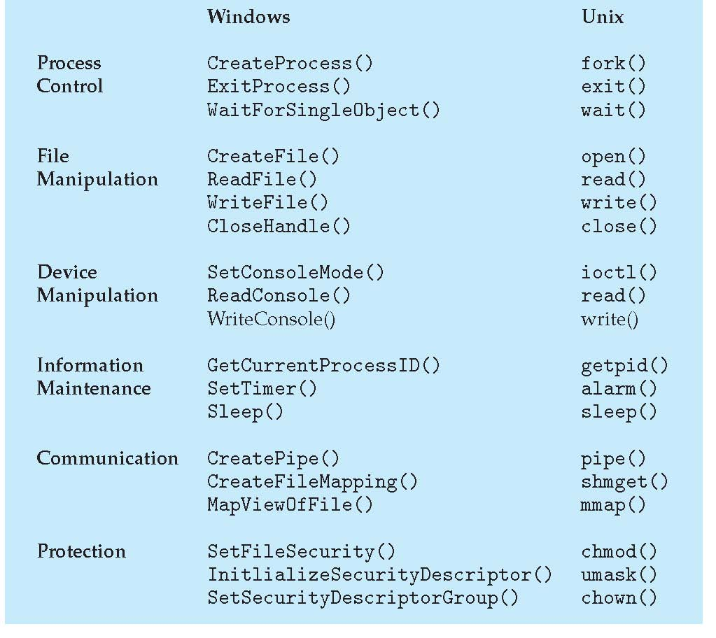
Examples of Windows and Unix System Calls

Slide 15
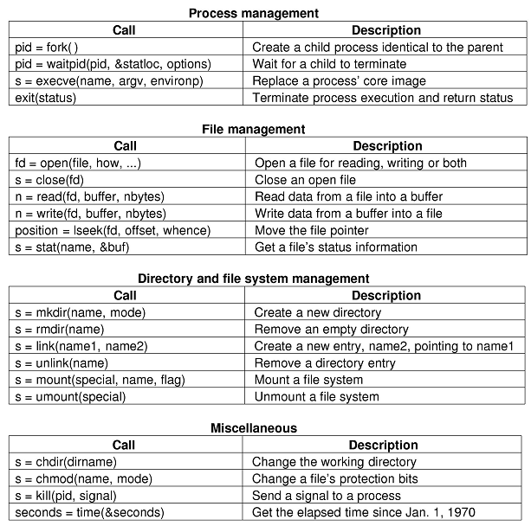
POSIX System Calls

Slide 16
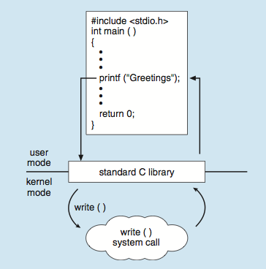
Standard C Library Example
C program invoking printf() library call, which calls write() system call

Slide 17
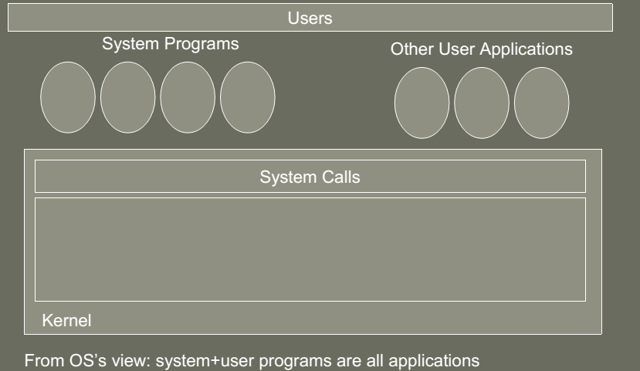
System programs

Slide 18
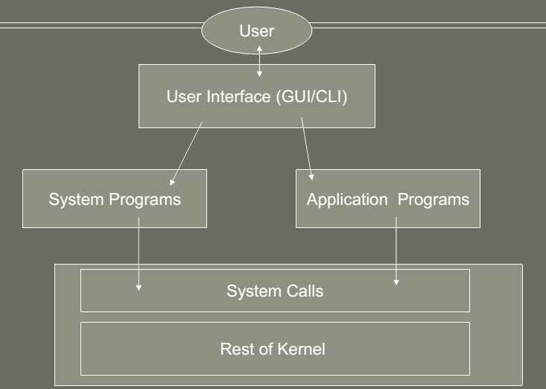
System programs

